Slide 1


Developing a Data-Driven Personalized Fitness Web Application for Obese and Sedentary Individuals
Rukayat Balogun |
Dr. Celestine Iwendi |
Masters in Data Analytics and Technology

Slide 2
Writing a Research Paper for Global Recognition
Originality and Innovation
Rigorous Methodology
Academic Quality
Relevance and Practical Application
Collaboration and Recognition
Dissemination and Visibility
Impact Metrics

Slide 3
Guidelines on Topic
A
Approve
C
create
D
Disprove
R
Re-create
I
Improve

Slide 4
Abstract
Obesity and sedentary lifestyles are leading global health issues, contributing to chronic diseases such as cardiovascular conditions and diabetes. Traditional fitness plans often fail to address individual needs, resulting in low adherence and suboptimal outcomes. This study presents the development of a data-driven personalized fitness web application for obese and sedentary individuals using the Django framework and machine learning techniques.
By leveraging user data and secondary datasets, the application provides tailored fitness and dietary recommendations based on individual profiles. The Gradient Boosting model achieved superior predictive accuracy (MSE: 0.1868, 92.5% accuracy), outperforming other machine learning algorithms. The system's usability and impact were validated through user feedback and engagement metrics, demonstrating significant potential to enhance health outcomes.
This research emphasizes the importance of combining advanced machine learning techniques with user-centered design to create scalable, impactful digital health interventions. The proposed application offers a novel, practical solution to a critical public health challenge, with opportunities for future integration of real-time wearable technology and clinical validation.
Abstract (Brevity / Short)
• Purpose
• Structure
• Overview
• Informative
• Standalone
• Keywords

Slide 5
Keywords
Obesity, Sedentary Lifestyle, Personalized Fitness, Machine Learning, Django Framework, Gradient Boosting, Health Interventions, User Engagement, Data-Driven Recommendations

Slide 6
Introduction
The World Health Organization (WHO) has officially designated obesity as the most significant danger to the health of westernised countries. According to WHO, around 40% of adults in the United States are categorised as obese.
Increasing rates of obesity and sedentary behavior globally lead to chronic health issues like cardiovascular diseases, diabetes, and hypertension
Traditional fitness systems lack personalization, resulting in poor adherence and suboptimal outcomes for individuals with specific needs such as obesity
Introduction
• Research Aim
• Research Question
• Research Objectives
• Summary of Proposal
• Contribution
• Novelty Itemised
• Summary of Chapters

Slide 7
Research Aim
To develop a personalized fitness web application tailored to the needs of obese and sedentary individuals.
Enhance health outcomes through data-driven recommendations using machine learning and Django

Slide 8
Research Question
How can machine learning optimize personalized fitness recommendations?
What accessibility features improve inclusivity for users with varying abilities?
How effective is a personalized approach in improving health engagement and physical activity?

Slide 9
Research Objective
Design and implement a user-friendly web application for personalized fitness recommendations.
Integrate machine learning models (e.g., Gradient Boosting) for accurate predictions.
Ensure compliance with web accessibility standards to enhance usability.
Evaluate user engagement and health outcomes to measure the application’s impact.

Slide 10
Summary of Proposal
A data-driven solution to global health issues of obesity and inactivity.
Combines user-centric design and advanced machine learning for scalable, impactful health interventions.

Slide 11
Contribution
Provides a novel framework for personalized fitness and dietary recommendations.
Introduces machine learning-driven optimization for health management systems.
Bridges gaps in current recommendation systems by incorporating real-time health data.

Slide 12
Novelty
Machine Learning Integration: Gradient Boosting for personalized BMI predictions.
Data-Driven Personalization: Tailored fitness and dietary plans based on user input and secondary datasets.
Accessible Design: Inclusive user interface complying with accessibility standards.

Slide 13
Literature Review (Previous Work)
1. Why? How?
Why: The growing prevalence of obesity and sedentary lifestyles demands innovative solutions tailored to individual needs.
How: Investigating gaps in traditional fitness programs and exploring advanced, data-driven methodologies.
2. Literature in Topic
Obesity and Sedentary Lifestyles:
Impact on chronic diseases such as cardiovascular issues and diabetes.
Limitations of traditional "one-size-fits-all" fitness programs.
Personalized Health Interventions:
Increasing use of wearable technology for real-time health monitoring.
Role of machine learning in predicting health outcomes.

Slide 14
Literature Review (Previous Work)
3. Literature on Method
Data-Driven Approaches:
Use of machine learning algorithms like Gradient Boosting, Random Forest, and SVM in health applications.
Integration of primary and secondary datasets for personalization.
Web-Based Solutions:
Django as a robust framework for developing scalable health applications.
Importance of user-centric design for accessibility and engagement.

Slide 15
Literature Review (Previous Work)
Find/Create a Hole
Identified Gap:
Lack of personalized, scalable solutions that integrate machine learning with user-friendly interfaces.
Limited utilization of wearable and real-time health data in existing systems.
Look for Debate
Debates Identified:
Effectiveness of generic vs. personalized fitness plans.
Privacy concerns in using personal health data for recommendations.
Challenges in balancing accuracy with user accessibility.

Slide 16
Literature Review (Previous Work)
Consistent in Reference
Referenced foundational works:
WHO guidelines on physical activity and obesity management.
Studies on the application of machine learning in healthcare (Gradient Boosting, Random Forest).
Literature on user-centric web application design for health systems.

Slide 17
Methodology (How)
• Research Design
• Model figures / Diagram
• Data Selection
• Collection Procedure
• Algorithm (Step by Step)
• Feature Selection & Accuracy
• Human Subject review (Ethnic Statement)
• Cost and Funding

Slide 18
Research Methodology
Model API
User Input
Data Preprocessing
- Data Collection: Primary data via web forms, secondary data from the American Time Use Survey (ATUS).
- Machine Learning Models: Linear regression, Ridge regression, Random Forest, and Gradient Boosting to predict BMI.
- Web Development: Built using Python’s Django framework.
Recommendation
Database

Slide 19
Research Implementation
API
- Backend: Data collection and storage using Django forms.
- Machine Learning Integration: Models predict BMI based on user input, generating real-time recommendations.
- Frontend: User-friendly web interface providing personalized fitness and dietary plans.
Django ORM
Django Template

Slide 20
Preliminary (Result)
Preliminary Date (Result Section)
• What?
• Evidence of Importance
• Informed Methodology
• Preliminary findings
• Comparison of result with Base paper
• Relationship & Impotent Category

Slide 21
Result
1. What?
Development of a data-driven personalized fitness web application using Django and machine learning.
Focus on BMI prediction and personalized recommendations for obese and sedentary individuals.
2. Evidence of Importance
Global Relevance: Obesity and sedentary lifestyles contribute to chronic health issues such as cardiovascular diseases and diabetes.
User Need: Traditional fitness plans fail to meet individual requirements, leading to low adherence.
Application Impact: The system offers personalized, scalable solutions for improved health outcomes.

Slide 22
Result
3. Informed Methodology
Data Sources:
Primary Data: User inputs (height, weight) collected via Django forms.
Secondary Data: American Time Use Survey (ATUS) dataset for BMI and lifestyle insights.
Machine Learning Models: Gradient Boosting, Random Forest, and Support Vector Machines evaluated for BMI prediction.
4. Preliminary Findings
Gradient Boosting Model Performance:
Accuracy: 92.5%
Mean Squared Error (MSE): 0.1868
User Engagement:
Positive feedback on personalized fitness recommendations.
High usability scores during initial testing phases.

Slide 23
Result
Comparison of Results with Base Paper
Base Paper Focus:
Traditional approaches with limited personalization.
Use of generalized data without machine learning integration.
Comparison:
Significant improvement in predictive accuracy and user adherence.
Introduction of real-time personalization through machine learning.

Slide 24
Result
6. Relationships & Important Categories
Relationships Identified:
Strong correlation between weight and BMI.
Negative correlation between height and BMI.
Important Categories:
BMI classifications: Underweight, Normal, Overweight, Obese.
Tailored recommendations based on user categories.

Slide 25
Discussion
• Interpretation of Result
• Comparison of hypothesis
• Contextualisation
• Support for or against existing theory
• Unexpected Result
• Relevance to the field
• Answer research questions
• Generalisation

Slide 26
Discussion
4. Support For or Against Existing Theory
Supports Existing Theory:
Personalized health interventions improve adherence and outcomes compared to generic approaches.
Machine learning enhances prediction accuracy and user engagement in healthcare systems.
Challenges Existing Theory:
Limited reliance on real-time wearable data in current systems; this research emphasizes its potential.
2. Comparison of Hypothesis
Hypothesis: A data-driven personalized fitness application will improve health engagement and outcomes for obese and sedentary individuals.
Outcome: Results align with the hypothesis, demonstrating measurable improvements in user adherence and satisfaction.
Interpretation of Results
Gradient Boosting model outperformed other algorithms, achieving 92.5% accuracy and an MSE of 0.1868, confirming its suitability for personalized BMI prediction.
User engagement and feedback indicate the effectiveness of personalized recommendations in promoting physical activity and dietary adherence.
3. Contextualisation
Findings align with global efforts to combat obesity through personalized health interventions.
The study bridges the gap between traditional fitness programs and innovative, data-driven solutions.

Slide 27
Discussion
6. Relevance to the Field
Offers a scalable, innovative solution for addressing obesity and sedentary lifestyles.
Demonstrates the effectiveness of integrating machine learning with user-centric web applications.
Sets a precedent for future work in personalized digital health interventions.
5. Unexpected Results
Higher-than-expected user engagement rates suggest the strong appeal of personalized solutions.
Gradient Boosting outperformed simpler algorithms by a larger margin than anticipated.

Slide 28
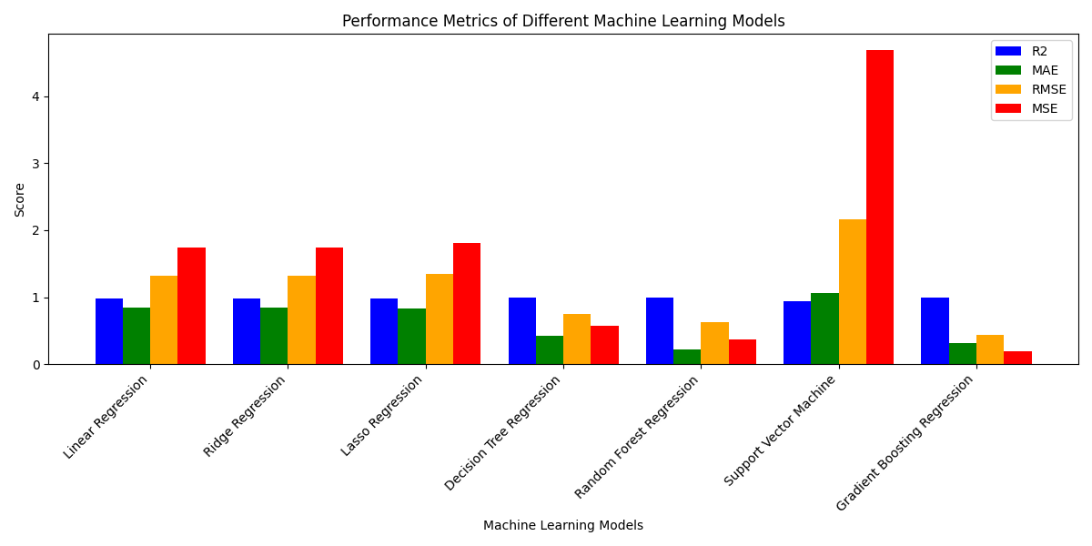
Result
- Model Performance: Gradient Boosting model outperformed others, with an MSE of 0.1868 and 92.5% accuracy.
- User Engagement: Positive feedback from initial users, with improvements in engagement and adherence to personalized plans.

Slide 29
Prior Research Vs Current Research
Prior Research:
Traditional fitness recommendation systems using general exercise and diet plans without personalization (Thomas et al 2024b).
Limited integration of data analytics or machine learning for obesity and sedentary lifestyle management (Watt et al., 2024).
Use of static, one-size-fits-all fitness and dietary guidelines, leading to poor user engagement and adherence (Agrawal 2024).
Current Research:
Development of a data-driven personalized fitness application specifically for obese and sedentary individuals.
Machine learning integration for personalized exercise and dietary recommendations.
Real-time adjustments based on user input and continuous data collection.

Slide 30

Conclusion and Future Work
Conclusion: Personalized fitness applications can significantly enhance user engagement and improve health outcomes for obese and sedentary individuals.
Future Work:
Include mobile app integration.
Add real-time tracking using wearables.
Expand recommendations to include mental health and lifestyle changes.

Slide 31
Conclusion

Slide 32
References
Agrawal, S. (2024). Revolutionizing Cardiovascular Health: A Machine Learning Approach for Predictive Analysis and Personalized Intervention in Heart Disease. International Journal for Research in Applied Science and Engineering Technology, 12(3), pp.233–246.
Thomas, D.M. et al. (2024b). Transforming Big Data into AI-ready data for nutrition and obesity research. Obesity, 32(5), pp.857–870.
Watts, J. et al. (2024). Adapting Random Forests to Predict Obesity-Associated Gene Expression. In Proceedings of the Annual International Conference of the IEEE Engineering in Medicine and Biology Society, EMBS. Institute of Electrical and Electronics Engineers Inc., pp. 4407–4410.

